Slide 1

CCE105 – DATA STRUCTURES
LESSON 3:
Stack and queue

Slide 2
STACK DATA STRUCTURES

Slide 3
Data Structures and Algorithm
STACK
A stack is a last-in/first-out (LIFO) structure.
All access to the stack are restricted to the topmost element
Referenced through an attribute called top.
An insertion to the stack is done via push operation,
Which always inserts the new element on top of the stack
A deletion from the stack is done via a pop operation
Which always removes and returns the element referenced by top.
The peek operation returns the element referenced by top but does not remove it.

Slide 4
Data Structures and Algorithm
Stack Specification (Stack ADT)
Description
This ADT describes a dynamic stack (size is not fixed) whose element type is left unspecified
Properties
Stacks are LIFO data structures
All accesses are done to the element referenced by top
The top always refers to the topmost element in the stack
Insertions are done “above” the top element

Slide 5
Data Structures and Algorithm
Stack Specification (Stack ADT)
Attributes
size – no. of elements in the stack: size >= 0 at all times
top – topmost element of the stack, null when stack is empty
Operations
Stack() – constructor
push()
Push element onto the top of the stack
Post-condition – element is placed on top of the stack, size is incremented by 1, top refers to the element pushed

Slide 6
Data Structures and Algorithm
Stack Specification (Stack ADT)
Operations
pop()
Pre-condition – isEmpty() is false
Remove and return the element at top
Post-condition – the top element is no longer in the stack, size is decremented by 1, top refers to the element below the previous topmost element or null if the stack is empty
Returns – the element removed

Slide 7
Data Structures and Algorithm
Stack Specification (Stack ADT)
Operations
peek()
Pre-condition – isEmpty() is false
Return the element at top
Post-condition – the stack is unchanged
Returns – the element referenced by top

Slide 8
Data Structures and Algorithm
Stack Specification (Stack ADT)
Operations
size()
Determine the number of elements in the stack
Post-condition – the stack is unchanged
Returns – the number of elements in the stack
isEmpty()
Determine if the stack has any elements in it
Post-condition – the stack is unchanged
Returns – true if the stack is empty (size() == 0), false otherwise

Slide 9
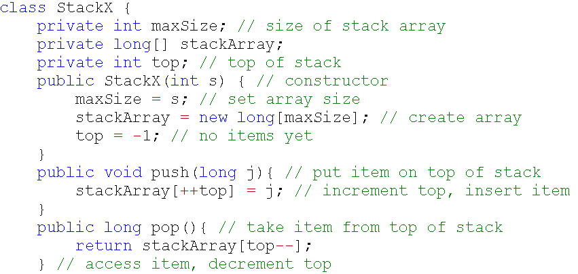
Data Structures and Algorithm
Stack Sample Program
Stack Sample Program 1

Slide 10
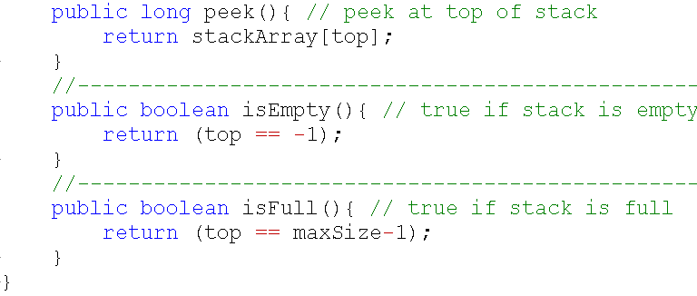
Data Structures and Algorithm
Stack Sample Program
Stack Sample Program 1

Slide 11
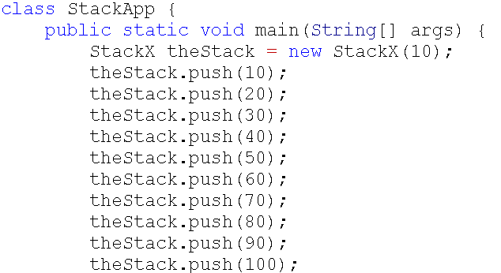
Data Structures and Algorithm
Stack Sample Program
stackArray = 10 //maxSize=10
top=-1
push(10)
stackArray[0] = 10 top=0
push(20)
stackArray[1] = 20 top=1
push(30)
stackArray[2] = 30 top=2
push(40)
stackArray[3] = 40 top=3
push(50)
stackArray[4] = 50 top=4
Stack Sample Program 1
push(60)
stackArray[5] = 60 top=5
push(70)
stackArray[6] = 70 top=6
push(80)
stackArray[7] = 80 top=7
push(90)
stackArray[8] = 90 top=8
push(100)
stackArray[9] = 100 top=9

Slide 12
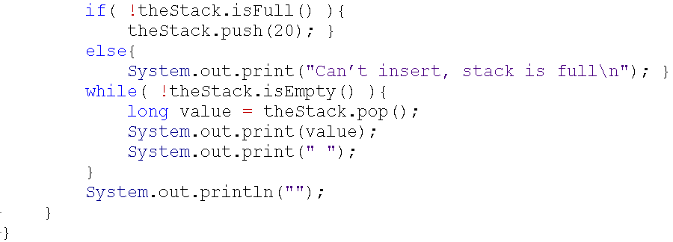
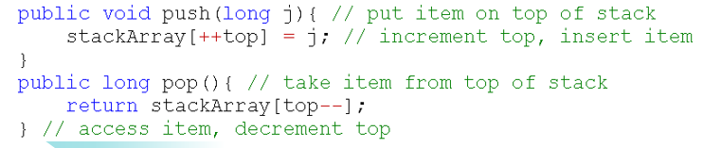

Data Structures and Algorithm
Stack Sample Program
!isFull()? F isFull (top==maxSize-1) top==9? T! = F
else
Output “Can’t insert, stack is full”
--while--
!isEmpty()? T isEmpty() (top==-1)? F! = T
value=pop() top=9 value=100
stackArray[top--] top=8
print 100
--while--
!isEmpty()? T isEmpty() (top==-1)? F! = T
value=pop() top=8 value=90
stackArray[top--] top=7
print 90
Stack Sample Program 1
--while--
!isEmpty()? T isEmpty() (top==-1)? F! = T
value=pop() top=7 value=80
stackArray[top--] top=6
print 80
OUTPUT
--while--
!isEmpty()? T isEmpty() (top==-1)? F! = T
value=pop() top= 6 value=70
stackArray[top--] top=5
print 70

Slide 13
Data Structures and Algorithm
--while--
!isEmpty()? T isEmpty() (top==-1)? F! = T
Stack Sample Program
value=pop() top=5 value=60
stackArray[top--] top=4
print 60
--while--
!isEmpty()? T isEmpty() (top==-1)? F! = T
value=pop() top=4 value=50
stackArray[top--] top=3
print 50
--while--
!isEmpty()? T isEmpty() (top==-1)? F! = T
value=pop() top=3 value=40
stackArray[top--] top=2
print 40
--while--
!isEmpty()? T isEmpty() (top==-1)? F! = T
--while--
!isEmpty()? T isEmpty() (top==-1)? F! = T
value=pop() top= 0 value=10
stackArray[top--] top=-1
print 10
value=pop() top= 2 value=30
stackArray[top--] top=1
print 30
Stack Sample Program 1
--while--
!isEmpty()? F
--while--
!isEmpty()? T isEmpty() (top==-1)? F! = T
value=pop() top= 1 value=20
stackArray[top--] top=0
print 30
OUTPUT

Slide 14
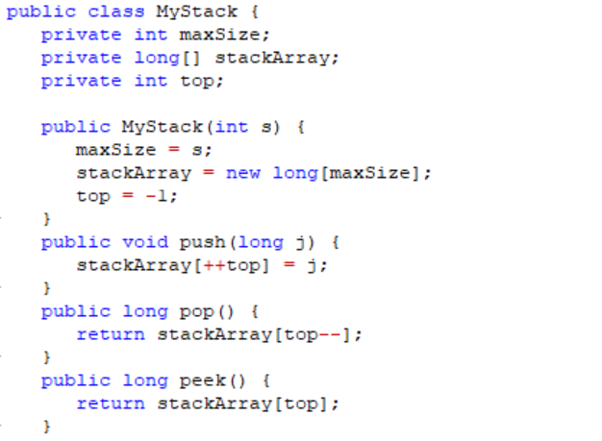
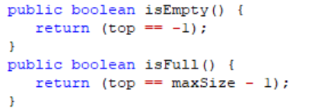
Data Structures and Algorithm
Stack Sample Program
Stack Sample Program 2

Slide 15
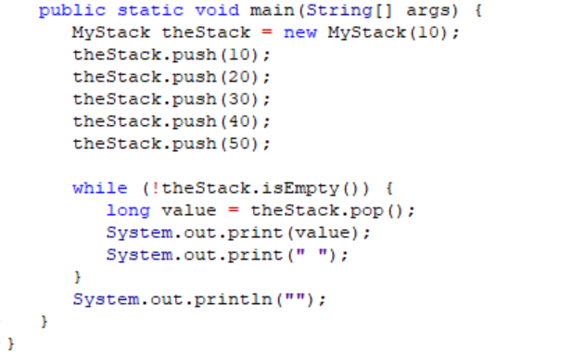

Data Structures and Algorithm
Stack Sample Program
Stack Sample Program 2
OUTPUT

Slide 16
QUESTIONS?
LESSON 3:
Stack and queue

